Slide 1
Session 11 : Basic XML Layouts
Module 4.1 : Android

Slide 2
Learning Objectives
At the end of the session successful participants will be able to
Create different layout using XML approach
Create different layout using Programming approach

Slide 3
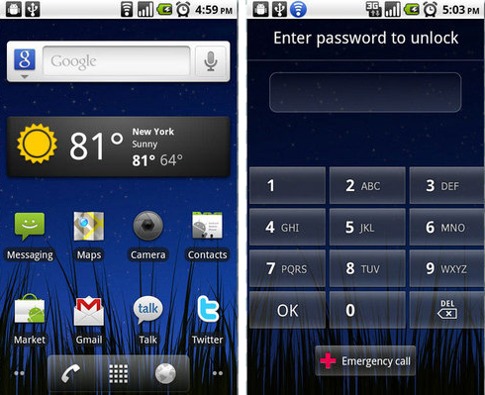
Basic XML Layouts
Containers
Your layout is the architecture for the user interface in an Activity. It defines the layout structure and holds all the elements that appear to the user.

Slide 4
Basic XML Layouts
Containers
You can declare your layout in two ways:
UI Elements In XML
Instantiate Layout Elements At Runtime

Slide 5
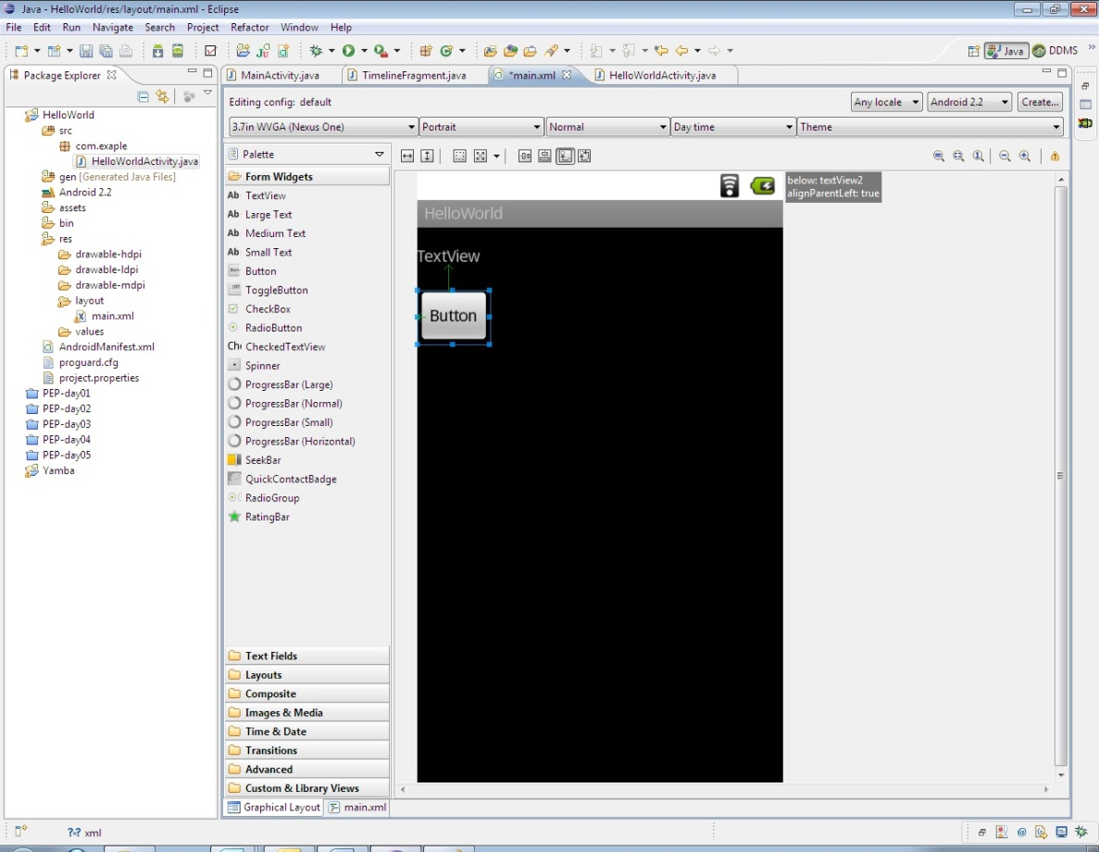
Basic XML Layouts
Containers
UI Elements In XML
Android provides a straightforward XML vocabulary that corresponds to the View classes and subclasses, such as those for widgets and layouts.

Slide 6
Basic XML Layouts
Containers
Instantiate Layout Elements At Runtime
Your application can create View and ViewGroup objects (and manipulate their properties) programmatically.
layout = new LinearLayout(this);
question = new TextView(this);
layout.setLayoutParams(new ViewGroup.LayoutParams(-1,-1));
layout.setBackgroundColor(R.color.blue);
question.setTextColor(R.color.green);
question.setTextSize(1,14);

Slide 7
Basic XML Layouts
Containers
Android’s LinearLayout offers a "box" model similar to the Java‐Swing Box‐Layout.
The general (and proven) strategy is to obtain the desired UI structure through the right combination of nested boxes.
In addition Android supports a range of containers providing different layout organizations.

Slide 8
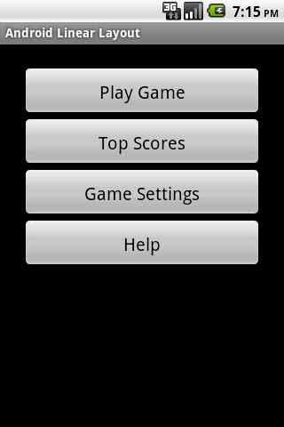
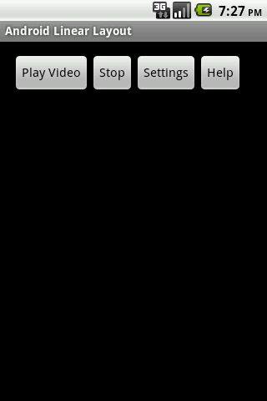
Basic XML Layouts
Containers
Commonly‐used Android containers are:
LinearLayout
The box model

Slide 9
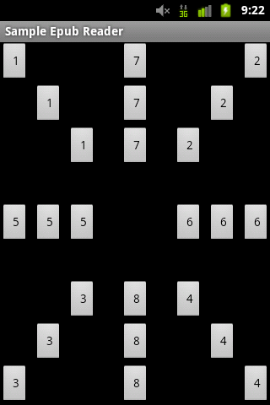
Basic XML Layouts
Containers
Commonly‐used Android containers are:
RelativeLayout
A rule‐based model

Slide 10
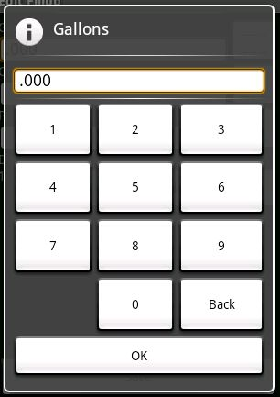
Basic XML Layouts
Containers
Commonly‐used Android containers are:
TableLayout
The grid model

Slide 11
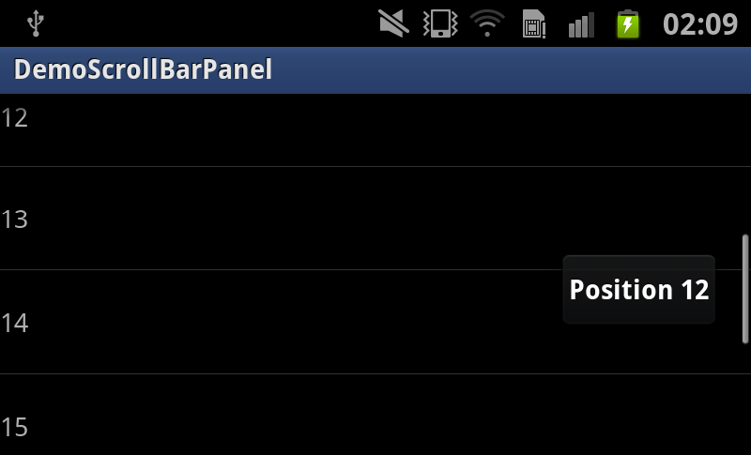
Basic XML Layouts
Containers
Commonly‐used Android containers are:
ScrollView
Scrolling model

Slide 12
Basic XML Layouts
Containers
Before we started…
Android’s simplest layout manager is called: Frame Layout.
A Frame Layout is a rectangular container that pins each child to its upper left corner.
Adding multiple views to a frame layout just stacks one on top of the other (overlapping the views)

Slide 13
Basic XML Layouts
Containers
Before we started… this slide in pdf is left-out

Slide 14
Basic XML Layouts
Containers
LinearLayout
LinearLayout is a box model – widgets or child containers are lined up in a column or row, one after the next.

Slide 15
Basic XML Layouts
Containers
LinearLayout
To configure a LinearLayout, you have five main areas of control besides the container's contents:
Orientation
Weight
Fill model
Gravity
Padding

Slide 16
Basic XML Layouts
Containers
LinearLayout: Oreintation
It indicates whether the LinearLayout represents a row or a column.
Add the android:orientation property to your LinearLayout element in your XML layout, setting the value to be horizontal for a row or vertical for a column.
A Frame Layout is a rectangular container that pins each child to its upper left corner.

Slide 17
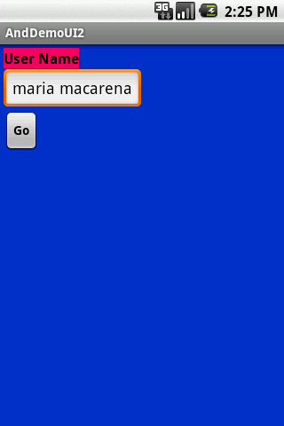
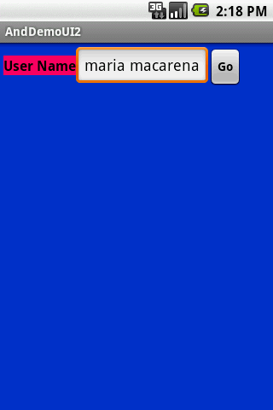
Basic XML Layouts
Containers
LinearLayout: Oreintation

Slide 18
Basic XML Layouts
Containers
LinearLayout: Oreintation
<?xml version="1.0" encoding="utf-8"?>
<LinearLayout
android:id="@+id/myLinearLayout"
android:layout_width="fill_parent"
android:layout_height="fill_parent"
android:background="#ff0033cc"
android:padding="4dip"
xmlns:android="http://schemas.android.com/apk/res/android"
android:orientation="horizontal" >
<TextView

Slide 19
Basic XML Layouts
Containers
LinearLayout: Oreintation
android:id="@+id/labelUserName"
android:layout_width="wrap_content"
android:layout_height="wrap_content"
android:background="#ffff0066"
android:text="User Name"
android:textSize="16sp"
android:textStyle="bold"
android:textColor="#ff000000"
>
</TextView>
<EditText

Slide 20
Basic XML Layouts
Containers
LinearLayout: Oreintation
android:id="@+id/ediName"
android:layout_width="wrap_content"
android:layout_height="wrap_content"
android:textSize="18sp"
></EditText><Button
android:id="@+id/btnGo"
android:layout_width="wrap_content"
android:layout_height="wrap_content"
android:text="Go"
android:textStyle="bold"
></Button></LinearLayout>

Slide 21
Basic XML Layouts
Containers
LinearLayout: Fill Model
Widgets have a "natural" size based on their accompanying text.
When their combined sizes does not exactly match the width of the Android device's screen, we may have the issue of what to do with the remaining space.

Slide 22
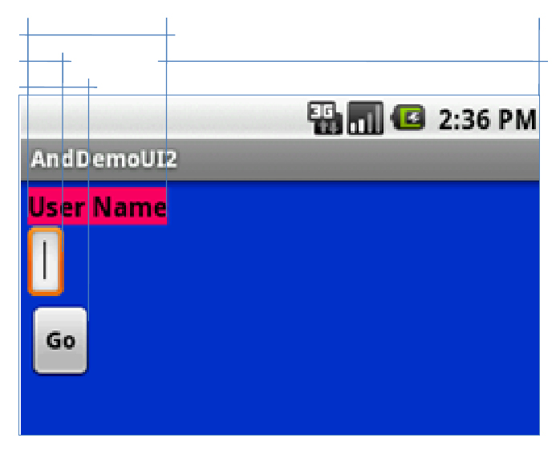
Basic XML Layouts
Containers
LinearLayout: Fill Model

Slide 23
Basic XML Layouts
Containers
LinearLayout: Fill Model
All widgets inside a LinearLayout must supply dimensional attributes to help address the issue of empty space.
android:layout_width and android:layout_height

Slide 24
Basic XML Layouts
Containers
LinearLayout: Fill Model
It indicates whether the LinearLayout represents row or column.
Specific a particular dimension, such as 125 pixels to indicate the widget should take up exactly 125 pixels.
Provide wrap content which means the widget should fill up its natural space, unless that is too big, in which case Android can use word‐wrap as needed to make it fit.
Provide fill_parent, which means the widget should fill up all available space in its enclosing container, after all other widgets are taken care of.

Slide 25
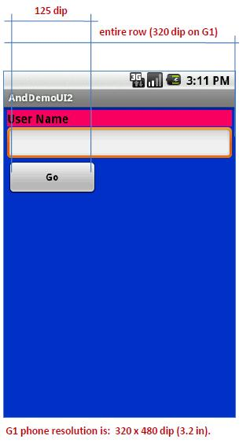
Basic XML Layouts
Containers
LinearLayout: Fill Model
<?xml version="1.0" encoding="utf-8"?>
<LinearLayout
android:id="@+id/myLinearLayout"
android:layout_width="fill_parent"
android:layout_height="fill_parent"
android:background="#ff0033cc"
android:padding="4dip"
android:orientation="vertical"
xmlns:android=http://schemas.android.com/apk/res/android>

Slide 26
Basic XML Layouts
Containers
LinearLayout: Fill Model
<TextView
android:id="@+id/labelUserName"
android:layout_width="fill_parent"
android:layout_height="wrap_content"
android:background="#ffff0066"
android:text="User Name"
android:textSize="16sp"
android:textStyle="bold"
android:textColor="#ff000000"
></TextView>

Slide 27
Basic XML Layouts
Containers
LinearLayout: Fill Model
<EditText android:id="@+id/ediName"
android:layout_width="fill_parent"
android:layout_height="wrap_content"
android:textSize="18sp"
></EditText><Button
android:id="@+id/btnGo"
android:layout_width="125dip"
android:layout_height="wrap_content"
android:text="Go"
android:textStyle="bold"
></Button></LinearLayout>

Slide 28
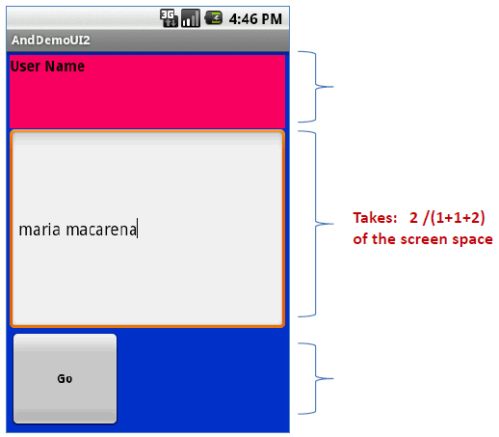
Basic XML Layouts
Containers
LinearLayout: Weight
It is used to proportionally assign space to widgets in a view.

Slide 29
Basic XML Layouts
Containers
LinearLayout: Weight
Example:
Both the TextView and the Button widgets have been set as in the previous example. Both have the additional property
android:layout_weight="1“
whereas the EditText control has
android:layout_weight="2"

Slide 30
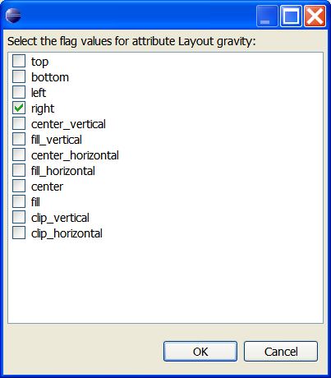
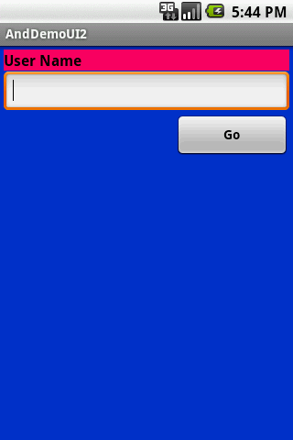
Basic XML Layouts
Containers
LinearLayout: Gravity
It is used to indicate how a control will align on the screen.
By default, widgets are left‐ and top‐aligned.
You may use the XML property android:layout_gravity=“…” to set other possible arrangements: left, center, right, top, bottom, etc.

Slide 31
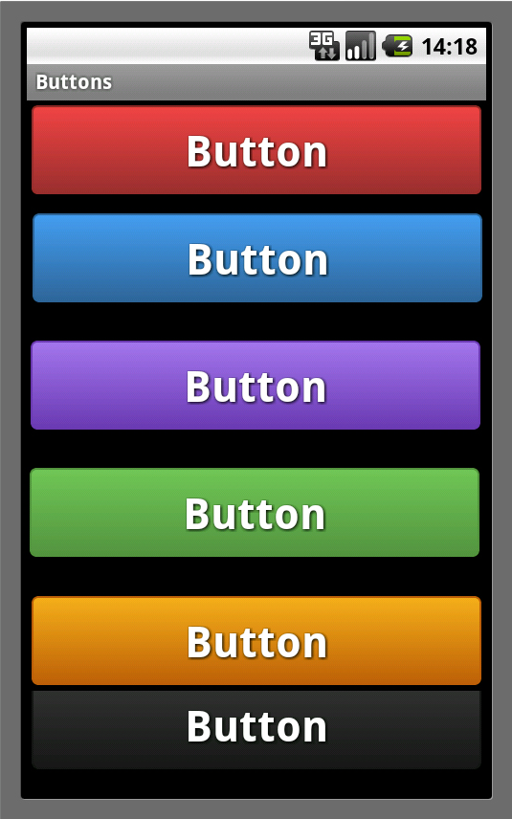
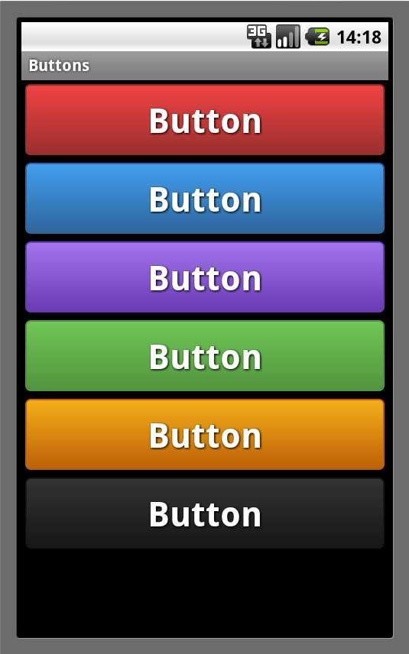
Basic XML Layouts
Containers
LinearLayout: Padding

Slide 32
Basic XML Layouts
Containers
LinearLayout: Padding
By default, widgets are tightly packed next to each other.
If you want to increase the whitespace between widgets, you will want to use the android:padding property (or by calling setPadding() at runtime on the widget's Java object).
The padding specifies how much space there is between the boundaries of the widget's "cell" and the actual widget contents.
Example: Padding is analogous to the margins on a word processing document.

Slide 33
Basic XML Layouts
Containers
LinearLayout: Padding
Padding
Top
Padding Left
Padding Right
widget
Padding Bottom
Widget Cell

Slide 34
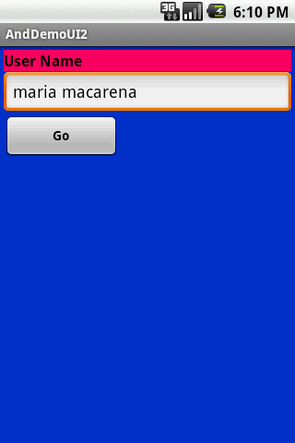
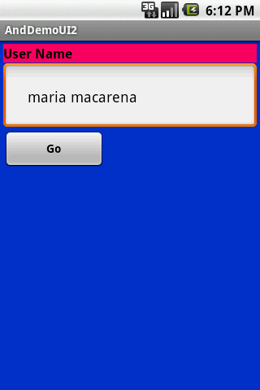
Basic XML Layouts
Containers
LinearLayout: Padding
Example: The EditText box has been changed to display 30 pixel of padding all around
<EditText
android:id="@+id/ediName"
android:layout_width="fill_parent"
android:layout_height="wrap_content"
android:textSize="18sp"
android:padding="30px“
></EditText>/EditText...

Slide 35
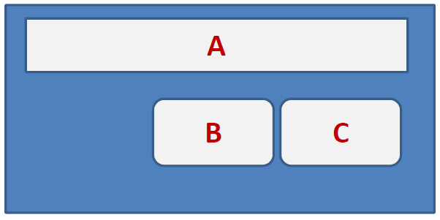
Basic XML Layouts
Containers
RelativeLayout
RelativeLayout places widgets based on their relationship to other widgets in the container and the parent container.

Slide 36
Basic XML Layouts
Containers
RelativeLayout – Referring to the container
Some positioning XML (boolean) properties mapping a widget according to its location respect to the parent’s place are:
android:layout_alignParentTop says the widget's top should align with the top of the container
android:layout_alignParentBottom the widget's bottom should align with the bottom of the container
android:layout_alignParentLeft the widget's left side should align with the left side of the container

Slide 37
Basic XML Layouts
Containers
RelativeLayout – Referring to the container
Some positioning XML (boolean) properties mapping a widget according to its location respect to the parent’s place are:
android:layout_alignParentRight the widget's right side should align with the right side of the container
android:layout_centerHorizontal the widget should be positioned horizontally at the center of the container
android:layout_centerVertical the widget should be positioned vertically at the center of the container

Slide 38
Basic XML Layouts
Containers
RelativeLayout – Referring to the container
Some positioning XML (boolean) properties mapping a widget according to its location respect to the parent’s place are:
android:layout_centerInParent the widget should be positioned both horizontally and vertically at the center of the container

Slide 39
Basic XML Layouts
Containers
RelativeLayout – Referring to the container
Relative Layout – Referring to other widgets
android:layout_above indicates that the widget should be placed above the widget referenced in the property
android:layout_below indicates that the widget should be placed below the widget referenced in the property
android:layout_toLeftOf indicates that the widget should be placed to the left of the widget referenced in the property

Slide 40
Basic XML Layouts
Containers
RelativeLayout – Referring to the container
Relative Layout – Referring to other widgets
android:layout_toRightOf indicates that the widget should be placed to the right of the widget referenced in the property
android:layout layout_alignTop indicates that the widget's top should be aligned with the top of the widget referenced in the property

Slide 41
Basic XML Layouts
Containers
RelativeLayout – Referring to the container
Relative Layout – Referring to other widgets
android:layout_alignBottom indicates that the widget's bottom should be aligned with the bottom of the widget referenced in the property
android:layout_alignLeft indicates that the widget's left should be aligned with the left of the widget referenced in the property

Slide 42
Basic XML Layouts
Containers
RelativeLayout – Referring to the container
Relative Layout – Referring to other widgets
android:layout_alignRight indicates that the widget's right should be aligned with the right of the widget referenced in the property
android:layout_alignBaseline indicates that the baselines of the two widgets should be aligned

Slide 43
Basic XML Layouts
Containers
RelativeLayout – Referring to the container
In order to use Relative Notation in Properties you need to consistently:
Put identifiers (android:id attributes) on all elements that you will need to address.
@+id/... (for instance an EditTextbox could be XML called: android:id="@+id/ediUserName")
Reference other widgets using the same identifier value (@+id/...) already given to a widget. For instance a control below the EditTextbox could say:
android:layout_below="@+id/ediUserName"

Slide 44
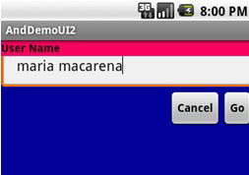
Basic XML Layouts
Containers
Example: RelativeLayout
<?xml version="1.0" encoding="utf-8"?>
<RelativeLayout
android:id="@+id/myRelativeLayout“ android:layout_width="fill_parent“ android:layout_height="fill_parent“ android:background="#ff000099“ xmlns:android="http://schemas.android.com/apk/res/android">
<TextView
android:id="@+id/lblUserName“ android:layout_width="fill_parent“ android:layout_height="wrap_content“

Slide 45
Basic XML Layouts
Containers
Example: RelativeLayout
android:background="#ffff0066“
android:text="User Name“ android:textStyle="bold“ android:textColor="#ff000000“ android:layout_alignParentTop="true“
android:layout_alignParentLeft="true">
</TextView><EditText
android:id="@+id/ediUserName“ android:layout_width="fill_parent“ android:layout_height="wrap_content“ android:layout_below="@+id/lblUserName“ android:layout_alignParentLeft="true“

Slide 46
Basic XML Layouts
Containers
Example: RelativeLayout
android:layout_alignLeft="@+id/myRelativeLayout" android:padding="20dip">
</EditText>
<Button
android:id="@+id/btnGo“ android:layout_width="wrap_content" android:layout_height="wrap_content" android:layout_below="@+id/ediUserName" android:layout_alignRight="@+id/ediUserName" android:text="Go" android:textStyle="bold"></Button><Button android:id="@+id/btnCancel”

Slide 47
Basic XML Layouts
Containers
Example: RelativeLayout
android:layout_width="wrap_content" android:layout_height="wrap_content" android:layout_toLeftOf="@+id/btnGo" android:layout_below="@+id/ediUserName" android:text="Cancel"
android:textStyle="bold">
</Button>
</RelativeLayout>

Slide 48
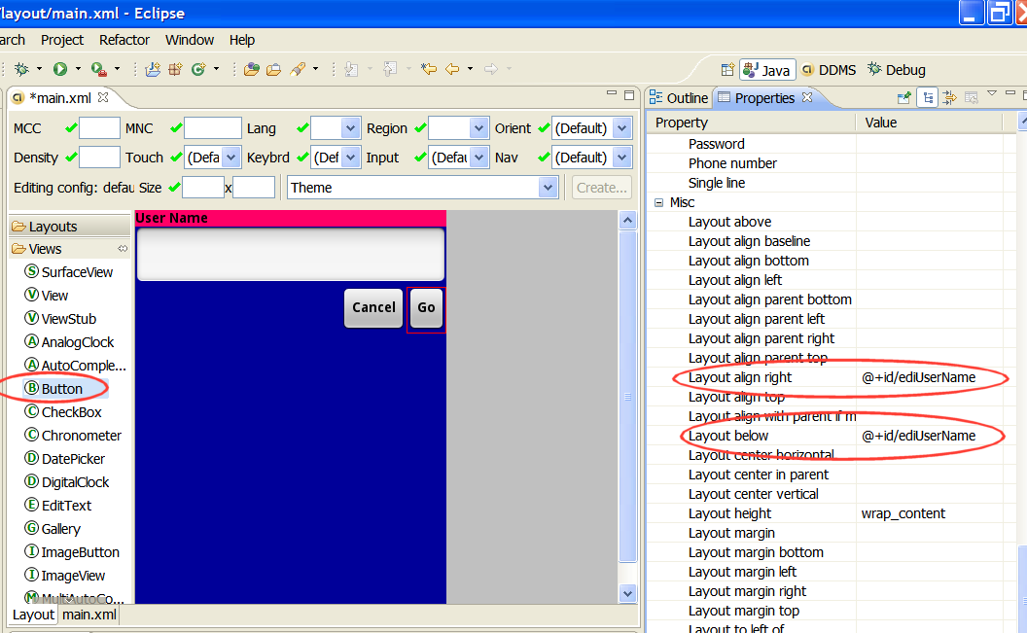
Basic XML Layouts
Containers
RelativeLayout - Comment
Use the Eclipse ADT Layout Editor for laying out RelativeLayouts. DroidDraw is of very little help in this respect.

Slide 49
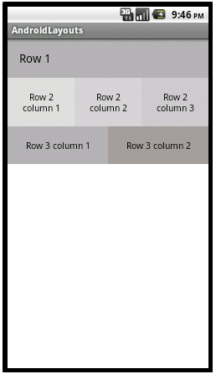
Basic XML Layouts
Containers
TableLayout
Android's TableLayout allows you to position your widgets in a grid made of identifiable rows and columns.
Columns might shrink or stretch to accommodate their contents.

Slide 50
Basic XML Layouts
Containers
TableLayout
TableLayout works in conjunction with TableRow.
TableLayout controls the overall behavior of the container, with the widgets themselves positioned into one or more TableRow containers, one per row in the grid.

Slide 51
Basic XML Layouts
Containers
TableLayout
Rows are declared by you by putting widgets as children of a TableRow inside the overall TableLayout.
The number of columns is determined by Android ( you control the number of columns in an indirect way).
So if you have three rows, one with two widgets, one with three widgets, and one with four widgets, there will be at least four columns.

Slide 52
Basic XML Layouts
Containers
TableLayout
However, a single widget can take up more than one column by including the android:layout_spanproperty, indicating the number of columns the widget spans (this is similar to the colspan attribute one finds in table cells in HTML)
<TableRow>
<TextViewandroid:text="URL:" />
<EditText
android:id="@+id/entry"
android:layout_span="3" />
</TableRow>

Slide 53
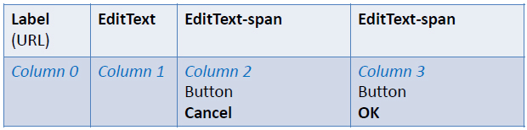
Basic XML Layouts
Containers
TableLayout
Ordinarily, widgets are put into the first available column of each row.
In the example below, the label (“URL”) would go in the first column (column 0, as columns are counted starting from 0), and the TextField would go into a spanned set of three columns (columns 1 through 3).
android:layout_columns="2"
android:layout_span="3"

Slide 54
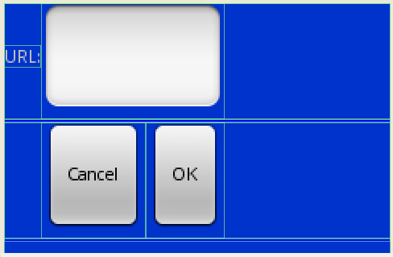
Basic XML Layouts
Containers
TableLayout: Example
<?xml version="1.0" encoding="utf-8"?>
<TableLayout
android:id="@+id/myTableLayout"
android:layout_width="fill_parent"
android:layout_height="fill_parent"
android:background="#ff0033cc"
android:orientation="vertical"
xmlns:android=http://schemas.android.com/apk/res/android
>
Note: Experiment changing layout_spanto 1, 2, 3

Slide 55
Basic XML Layouts
Containers
TableLayout: Example
<TableRow>
<TextView
android:text="URL:" />
<EditTextandroid:id="@+id/ediUrl"
android:layout_span="3"/>
</TableRow>
<View
android:layout_height="3dip"
android:background="#0000FF" />
<TableRow>
Note: Experiment changing layout_spanto 1, 2, 3

Slide 56
Basic XML Layouts
Containers
TableLayout: Example
<Button android:id="@+id/cancel"
android:layout_column="2"
android:text="Cancel" />
<Button android:id="@+id/ok"
android:text="OK" />
</TableRow>
<View
android:layout_height="3dip"
android:background="#0000FF" />
</TableLayout>

Slide 57
Basic XML Layouts
Containers
TableLayout: Example
By default, each column will be sized according to the "natural" size of the widest widget in that column.
If your content is narrower than the available space, you can use the TableLayout property:
android:stretchColumns=“…”
Its value should be a single column number (0-based) or a comma-delimited list of column numbers. Those columns will be stretched to take up any available space yet on the row.

Slide 58
Basic XML Layouts
Containers
TableLayout: Example
In our running example we stretch columns 2, 3, and 4 to fill the rest of the row.
... <TableLayout
android:id="@+id/myTableLayout"
android:layout_width="fill_parent"
android:layout_height="fill_parent"
android:background="#ff0033cc"
android:orientation="vertical"
android:stretchColumns ="2,3,4"
xmlns:android="http://schemas.android.com/apk/res/android”> ...

Slide 59
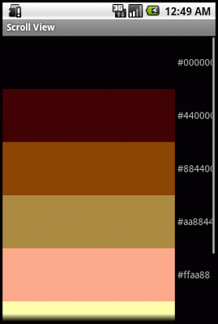
Basic XML Layouts
Containers
ScrollView Layout

Slide 60
Basic XML Layouts
Containers
ScrollView Layout
When we have more data than what can be shown on a single screen you may use the ScrollView control.
It provides a sliding or scrolling access to the data. This way the user can only see part of your layout at one time, but the rest is available via scrolling.
This is similar to browsing a large web page that forces the user to scroll up the page to see the bottom part of the form.

Slide 61
Basic XML Layouts
Containers
ScrollView Layout: Example
<?xmlversion="1.0"encoding="utf-8"?>
<ScrollView
android:id="@+id/myScrollView1"
android:layout_width="fill_parent"
android:layout_height="fill_parent"
android:background="#ff009999"
xmlns:android="http://schemas.android.com/apk/res/android"
>
<LinearLayout
android:id="@+id/myLinearLayoutVertical”

Slide 62
Basic XML Layouts
Containers
ScrollView Layout: Example
android:layout_width="fill_parent"
android:layout_height="fill_parent"
android:orientation="vertical"
>
<LinearLayout
android:id="@+id/myLinearLayoutHorizontal1"
android:layout_width="fill_parent"
android:layout_height="fill_parent"
android:orientation="horizontal"
>
<ImageView

Slide 63
Basic XML Layouts
Containers
ScrollView Layout: Example
android:id="@+id/myPicture"
android:layout_width="wrap_content"
android:layout_height="wrap_content"
android:src="@drawable/icon"/>
<TextView
android:id="@+id/textView1"
android:layout_width="fill_parent"
android:layout_height="wrap_content"
android:text="Line1"
android:textSize="70dip"/>
</LinearLayout>

Slide 64
Basic XML Layouts
Containers
ScrollView Layout: Example
<View
android:layout_width="fill_parent"
android:layout_height="6dip"
android:background="#ffccffcc"/>
<TextView
android:id="@+id/textView2"
android:layout_width="fill_parent"
android:layout_height="wrap_content"
android:text="Line2"
android:textSize="70dip"/>
<View

Slide 65
Basic XML Layouts
Containers
ScrollView Layout: Example
android:layout_width="fill_parent"
android:layout_height="6dip"
android:background="#ffccffcc"/>
<TextView
android:id="@+id/textView3"
android:layout_width="fill_parent"
android:layout_height="wrap_content"
android:text="Line3"
android:textSize="70dip"/>
<View
android:layout_width="fill_parent”

Slide 66
Basic XML Layouts
Containers
ScrollView Layout: Example
android:layout_height="6dip"
android:background="#ffccffcc"/>
<TextView
android:id="@+id/textView4"
android:layout_width="fill_parent"
android:layout_height="wrap_content"
android:text="Line4"
android:textSize="70dip"/>
<View
android:layout_width="fill_parent"
android:layout_height="6dip”

Slide 67
Basic XML Layouts
Containers
ScrollView Layout: Example
android:background="#ffccffcc"/>
<TextView
android:id="@+id/textView5"
android:layout_width="fill_parent"
android:layout_height="wrap_content"
android:text="Line5"
android:textSize="70dip"/>
</LinearLayout>
</ScrollView>

Slide 68
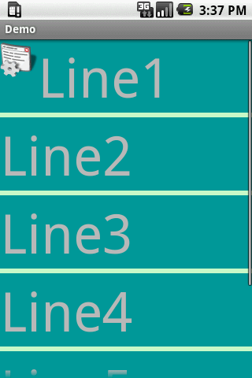
Basic XML Layouts
Containers
ScrollView Layout: Example
Combining an ImageView & TextView in a horizontal Linear Layout
Simple TextView
Scroller

Slide 69
Basic XML Layouts
Containers
ScrollView Layout: Example
<?xml version="1.0" encoding="utf-8"?>
<ScrollView
xmlns:android="http://schemas.android.com/apk/res/android"
android:layout_width="fill_parent"
android:layout_height="wrap content">
<TableLayout
android:layout_width="fill_parent"
android:layout_height="fill_parent"
android:stretchColumns="0">
<TableRow>

Slide 70
Basic XML Layouts
Containers
ScrollView Layout: Example
<View
android:layout_height="80px"
android:background="#000000"/>
<TextView android:text="#000000"
android:paddingLeft="4px"
android:layout_gravity="center_vertical" />
</TableRow>
<TableRow>
<View
android:layout_height="80px"
android:background="#440000" />

Slide 71
Basic XML Layouts
Containers
ScrollView Layout: Example
<TextView android:text="#440000"
android:paddingLeft="4px"
android:layout_gravity="center_vertical" />
</TableRow>
<TableRow>
<View
android:layout_height="80px"
android:background="#884400" />
<TextView android:text="#884400"
android:paddingLeft="4px"
android:layout_gravity="center_vertical" />

Slide 72
Basic XML Layouts
Containers
ScrollView Layout: Example
</TableRow>
<TableRow>
<View
android:layout_height="80px"
android:background="#aa8844" />
<TextView android:text="#aa8844"
android:paddingLeft="4px"
android:layout_gravity="center vertical" />
</TableRow>
<TableRow>
<View

Slide 73
Basic XML Layouts
Containers
ScrollView Layout: Example
android:layout_height="80px"
android:background="#ffaa88" />
<TextView android:text="#ffaa88"
android:paddingLeft="4px"
android:layout_gravity="center_vertical" />
</TableRow>
<TableRow>
<View
android:layout_height="80px"
android:background="#ffffaa" />
<TextView android:text="#ffffaa”

Slide 74
Basic XML Layouts
Containers
ScrollView Layout: Example
android:paddingLeft="4px"
android:layout_gravity="center_vertical" />
</TableRow>
<TableRow>
<View
android:layout_height="80px"
android:background="#ffffff" />
<TextView android:text="#ffffff"
android:paddingLeft="4px"
android:layout_gravity="center_vertical" />
</TableRow></TableLayout></ScrollView>

Slide 75
Basic XML Layouts
Containers
ScrollView Layout: Example

Slide 76
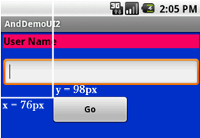
Basic XML Layouts
Containers
Miscellaneous: Absolute Layout
A layout that lets you specify exact locations (x/y coordinates) of its children.
Absolute layouts are less flexible and harder to maintain than other types of layouts without absolute positioning.

Slide 77
Basic XML Layouts
Containers
Miscellaneous: Absolute Layout
<?xml version="1.0" encoding="utf-8"?><AbsoluteLayout
android:id="@+id/myLinearLayout"
android:layout_width="fill_parent"
android:layout_height="fill_parent"
android:background="#ff0033cc"
android:padding="4dip"
xmlns:android="http://schemas.android.com/apk/res/android"
>
<TextView
android:id="@+id/tvUserName”

Slide 78
Basic XML Layouts
Containers
Miscellaneous: Absolute Layout
android:layout_width="fill_parent"
android:layout_height="wrap_content"
android:background="#ffff0066"
android:text="User Name"
android:textSize="16sp"
android:textStyle="bold"
android:textColor="#ff000000"android:layout_x="0dip"android:layout_y="10dip"
>
</TextView>
<EditText

Slide 79
Basic XML Layouts
Containers
Miscellaneous: Absolute Layout
android:id="@+id/etName"
android:layout_width="fill_parent"
android:layout_height="wrap_content"
android:textSize="18sp"android:layout_x="0dip"android:layout_y="38dip”></EditText>
<Button android:layout_width="120dip"
android:text="Go"
android:layout_height="wrap_content"
android:textStyle="bold"
android:id="@+id/btnGo" android:layout_x="100dip" android:layout_y="170dip”/></AbsoluteLayout>

